Slide 1
Remote Sensing for observation and monitoring of the world
Chandra Giri, Ph.D.
Chief,
Sensing and Spatial Analysis Branch EMMD/NERL,
Office of Research and Development,
United States Environmental Protection Agency (EPA))

Slide 2
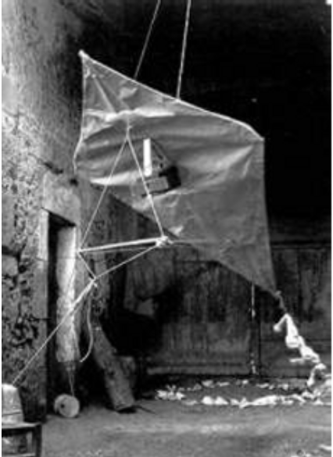
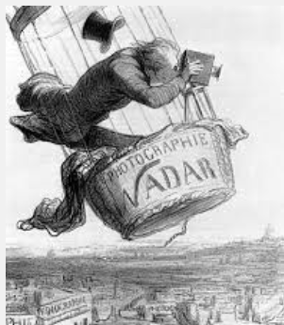
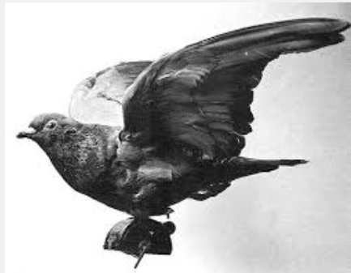
Aerial Photography
French balloonist and photographer Gaspard Felix Tournachon attempted (without great success) to perform land surveys in 1859 using photos taken from tethered balloons

Slide 3
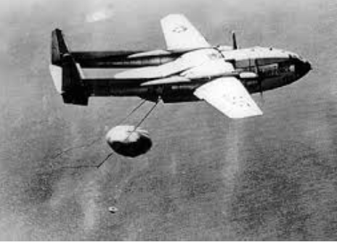
Aircrafts

Slide 4
1950s and 1970s
Term Remote Sensing was introduced
Airplanes to Satellites
Analog to digital..computer to analyze
Concern for environmental monitoring
CORONA – US 1st Satellite (1959)
U-2 Aircraft Reconnaissance Program
Landsat Program

Slide 5
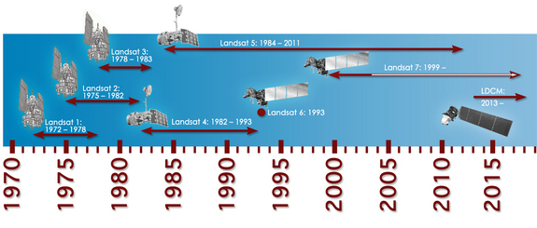
Longest satellite record

Slide 7
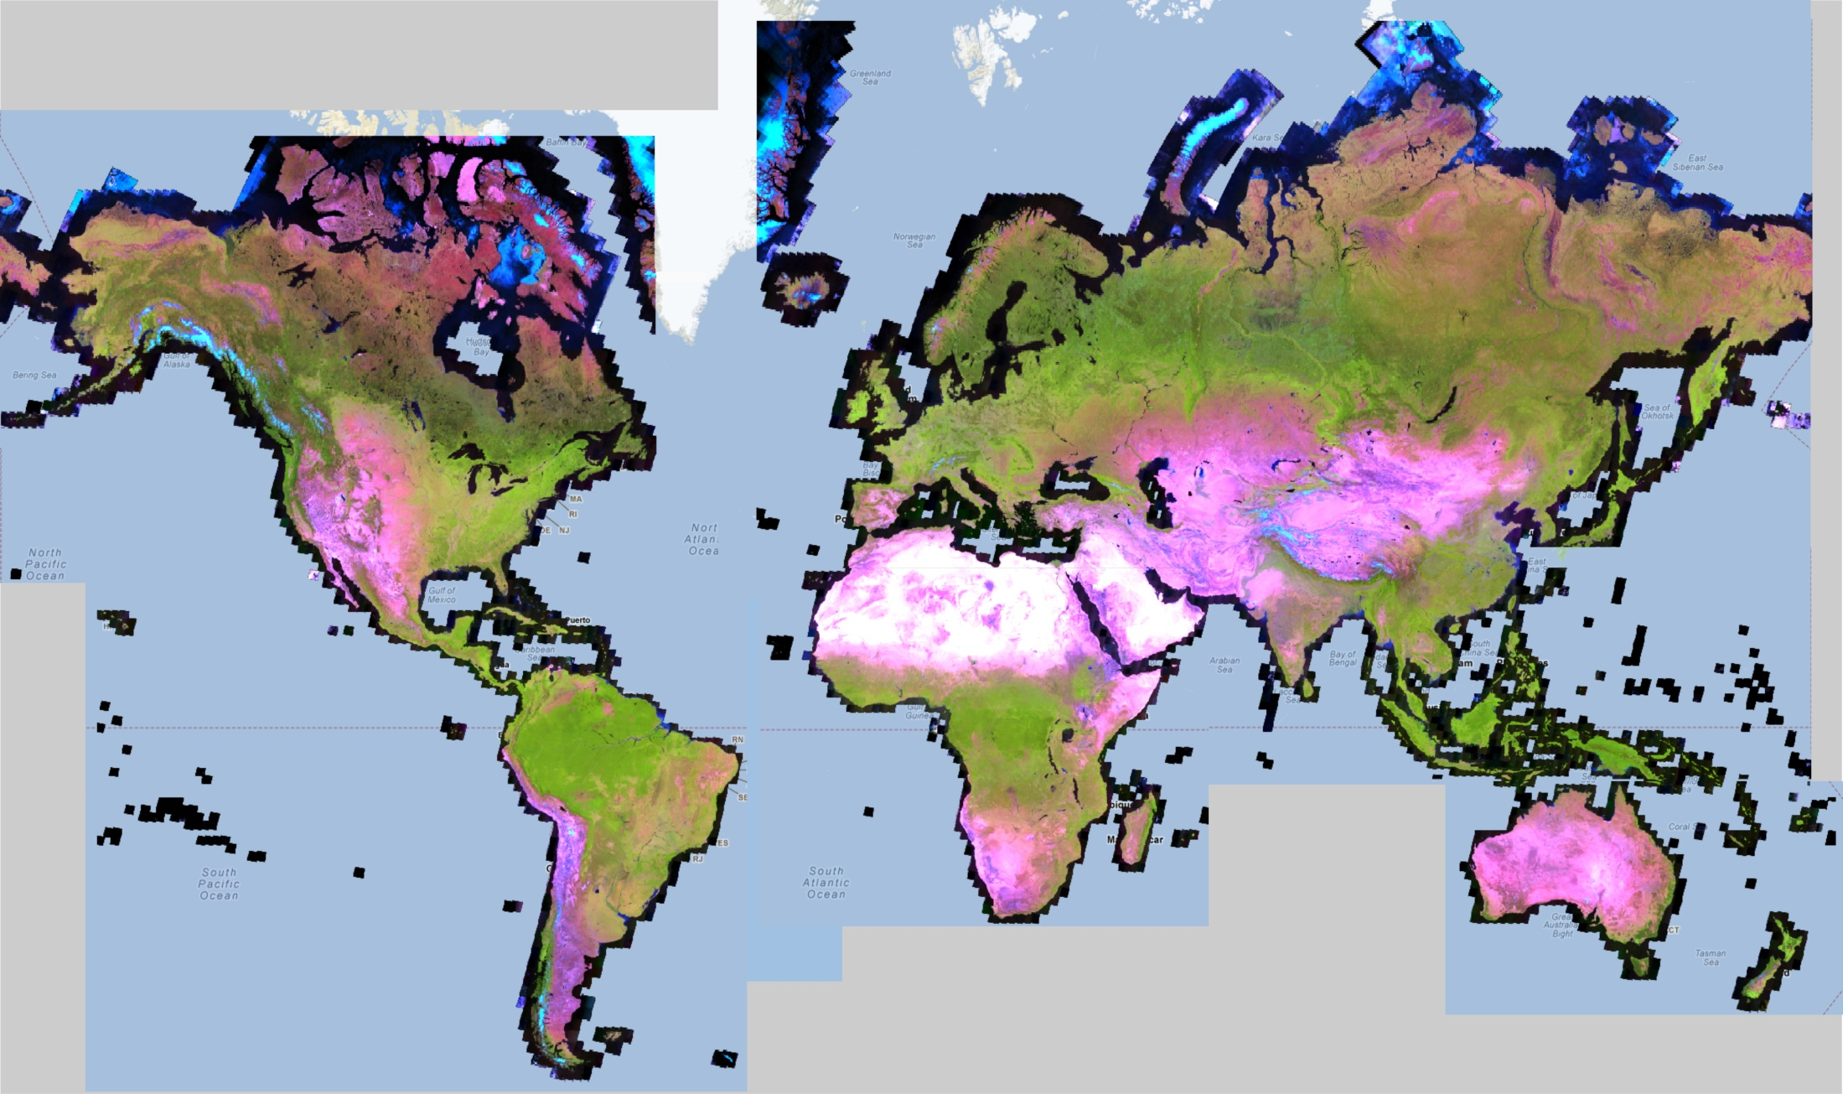
Global Landsat – cloud-free

Slide 8
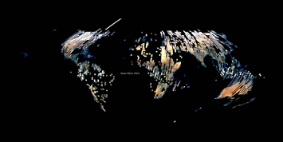
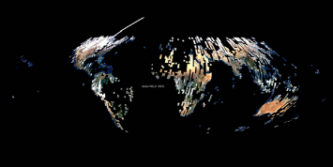
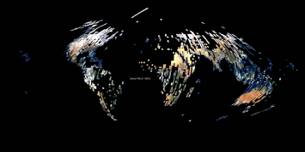
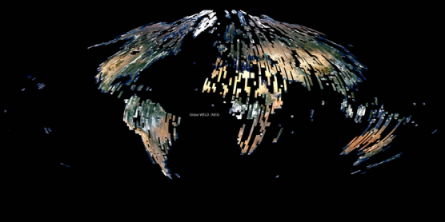
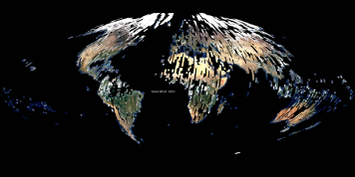
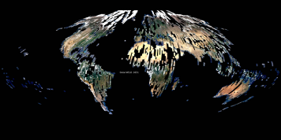
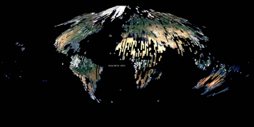
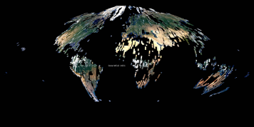
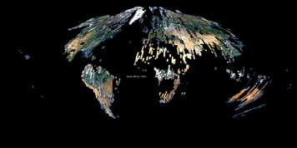
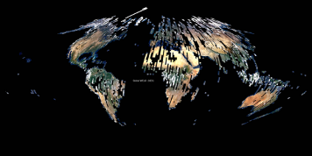
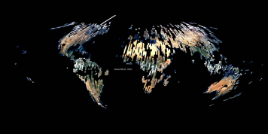
Dec. 2009
Jan. 2010
Feb. 2010
March 2010
April 2010
May 2010
June 2010
July 2010
August 2010
Sept. 2010
Oct. 2010
Nov. 2010

Slide 9
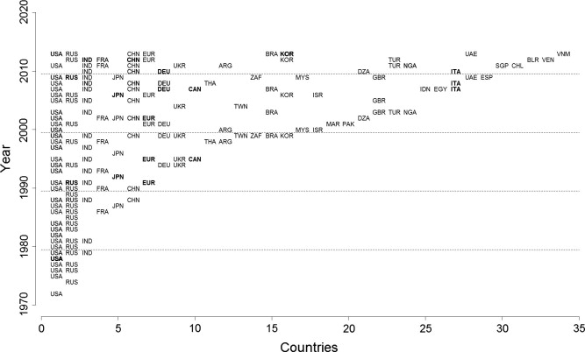

Slide 10
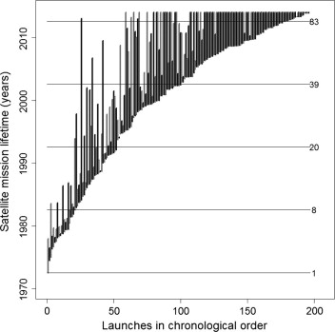

Slide 11
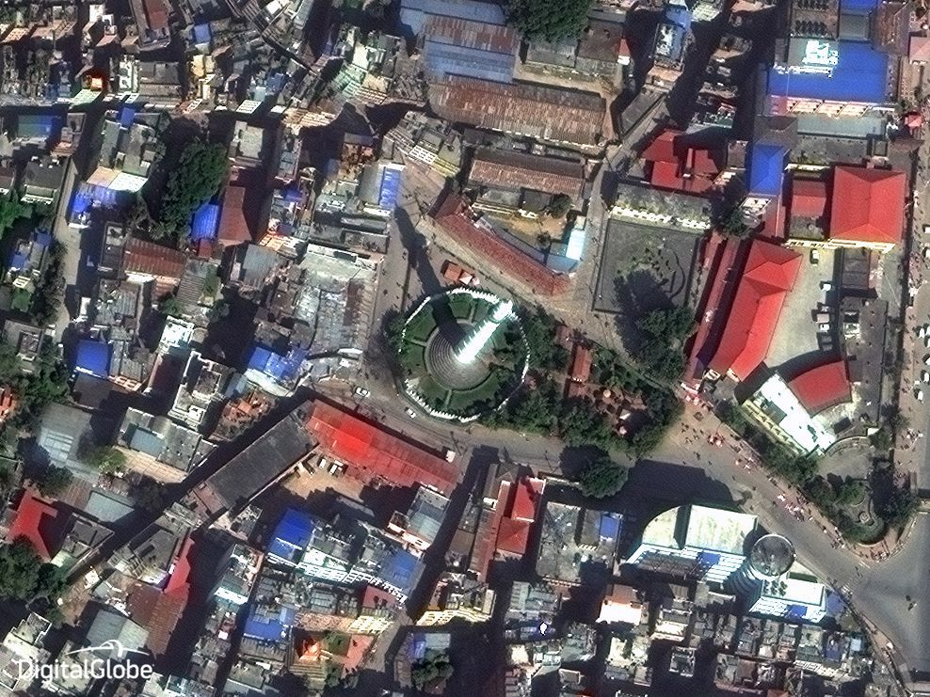
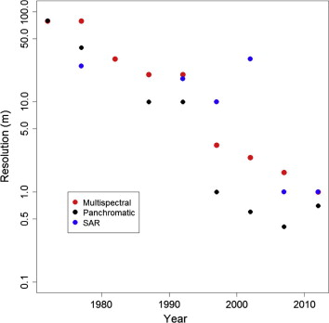

Slide 12
Data, Data, Data
Computing
Methods
Improve our scientific knowledge & understandings of land cover & land cover change
Science & Engineering

Slide 13
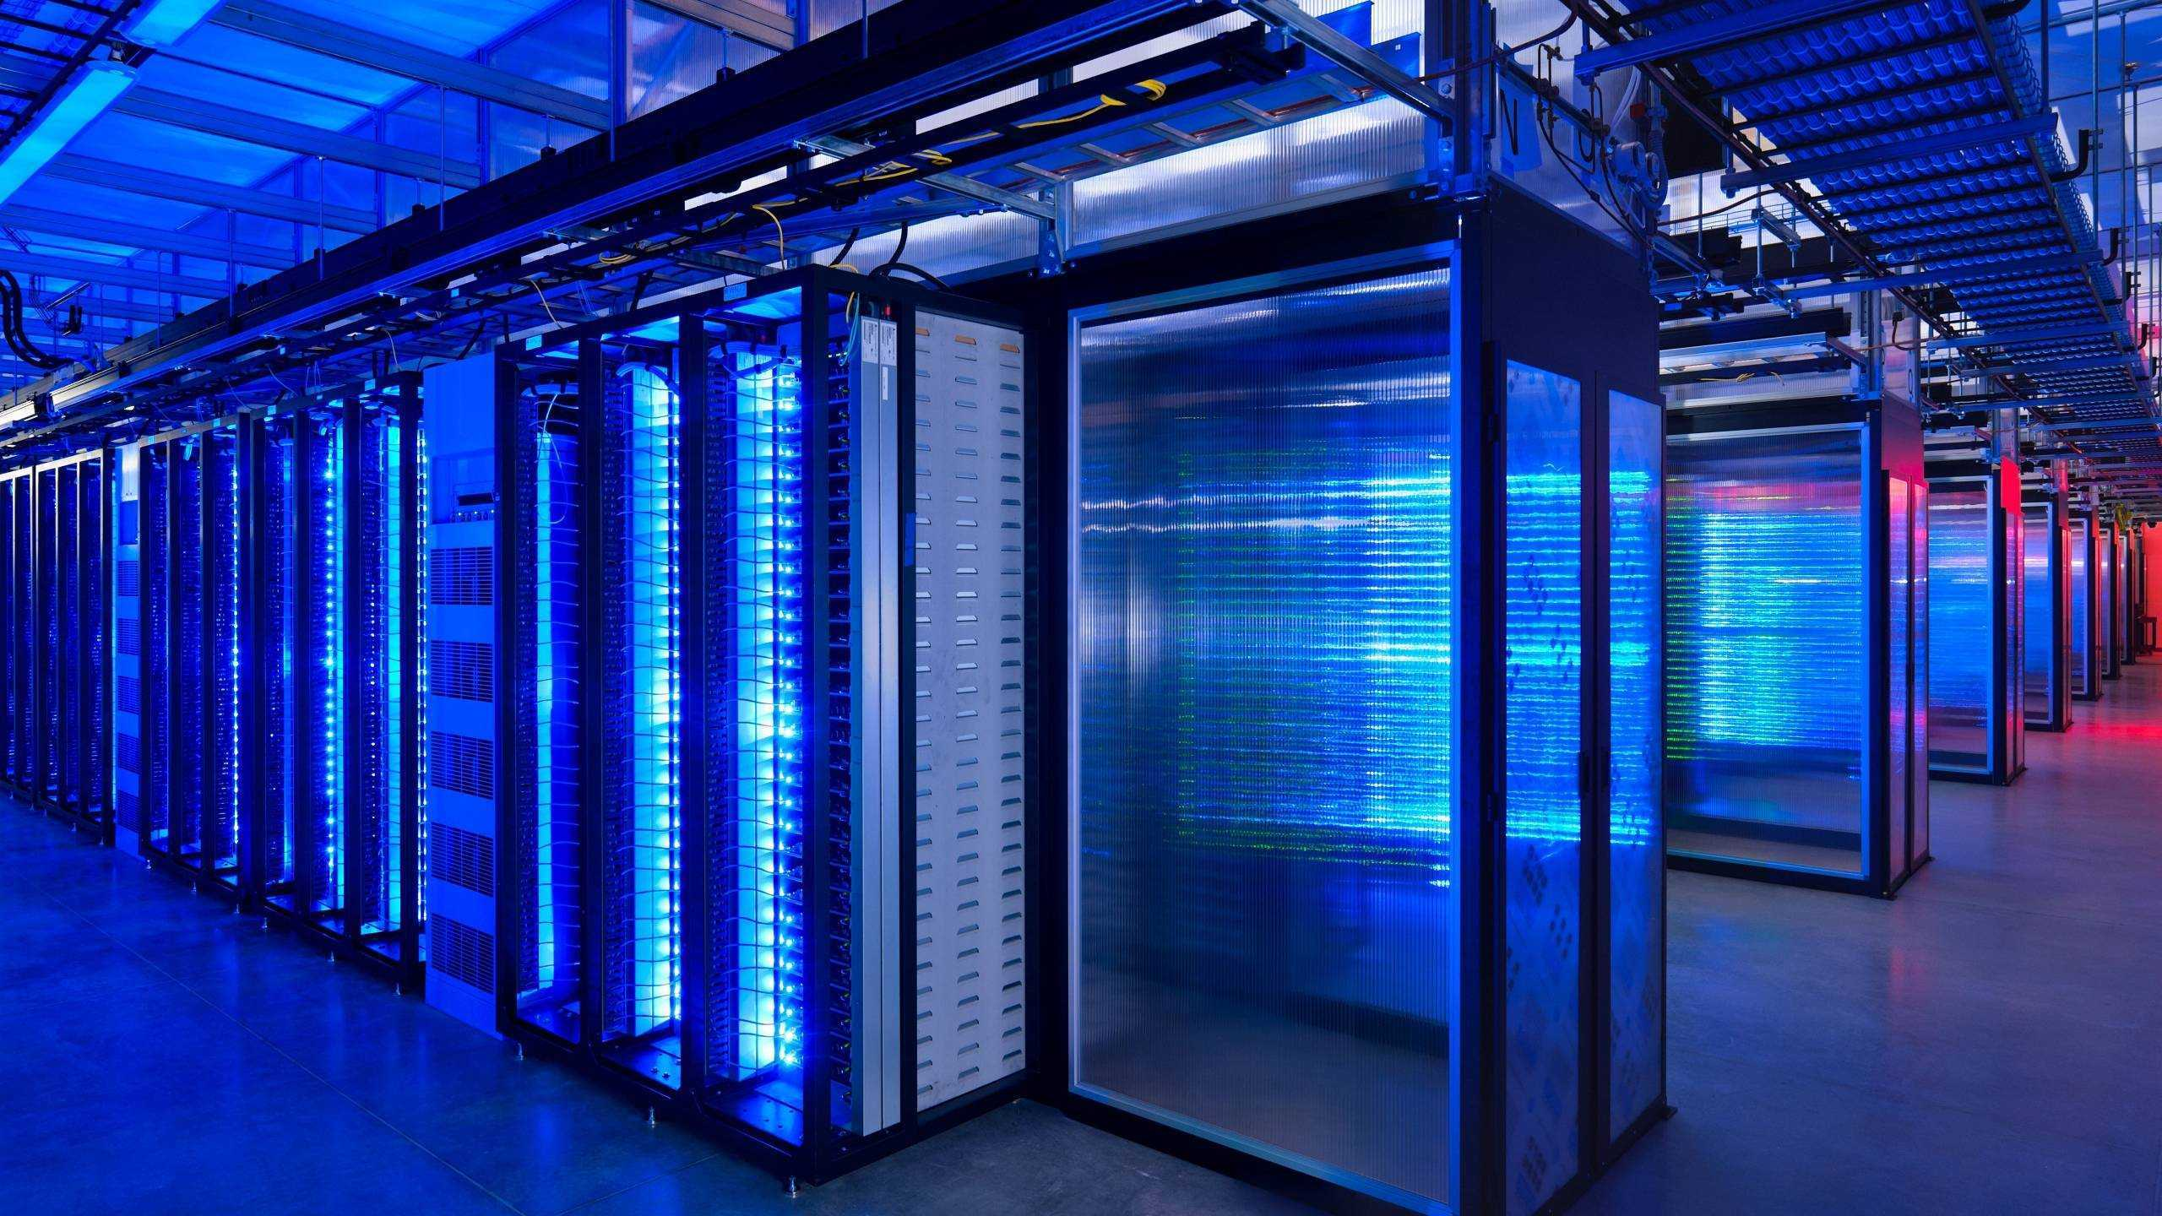
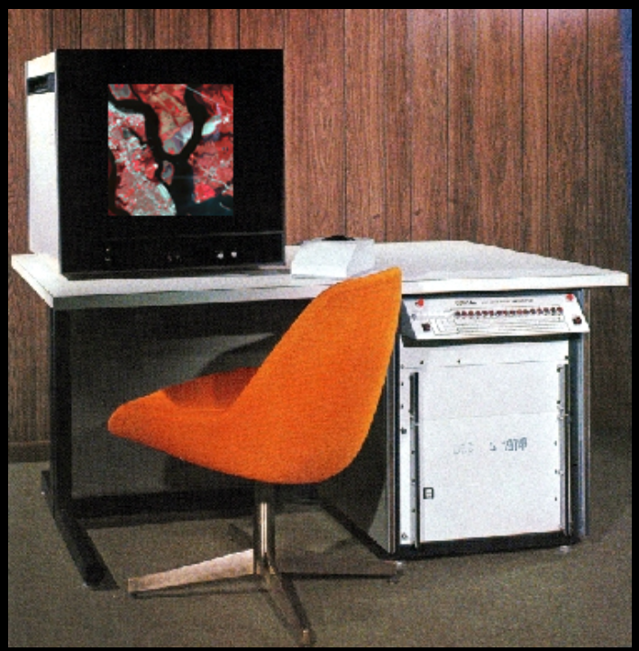
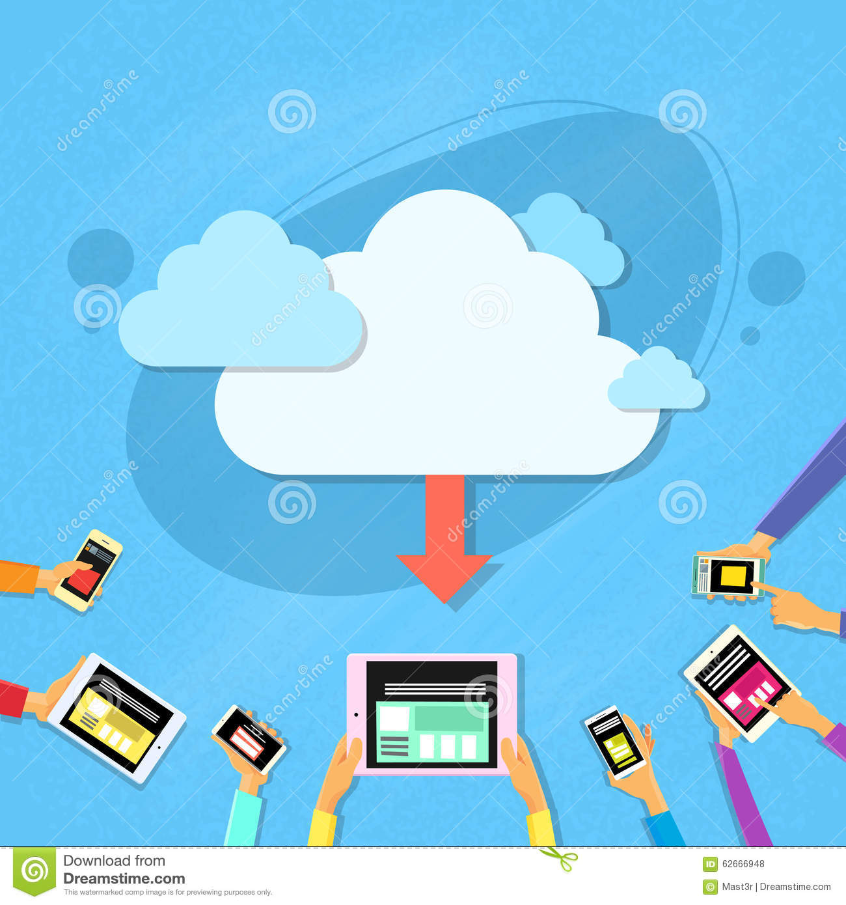
Computer Technology
Disk Space, Computing processor, Software, Algorithms, Network professionals

Slide 14
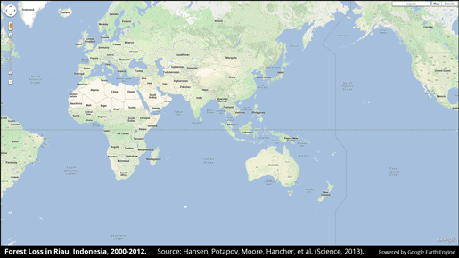
Global map of forest change:
http://earthenginepartners.appspot.com/science-2013-global-forest

Slide 15
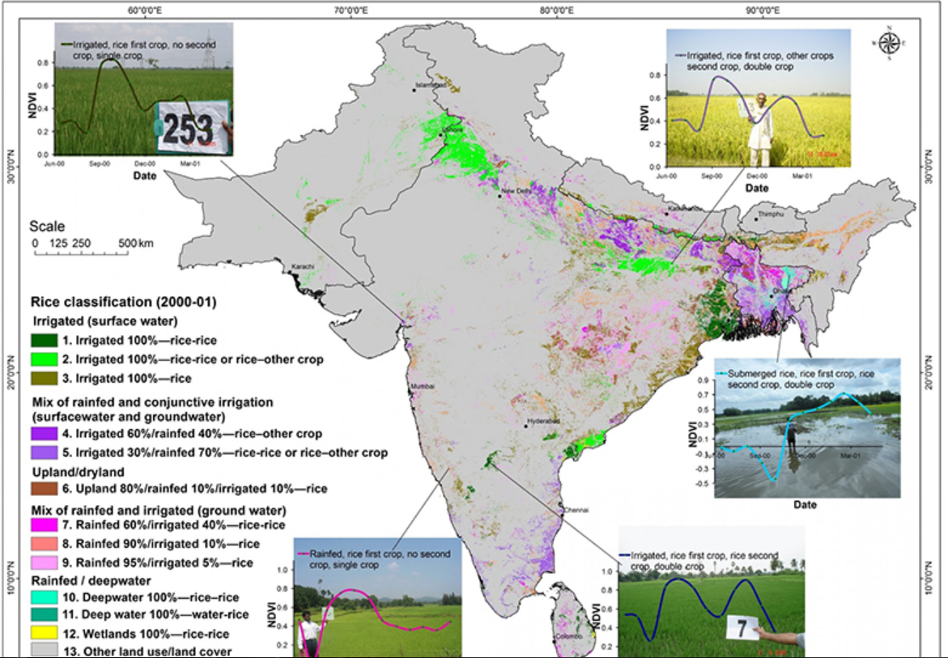
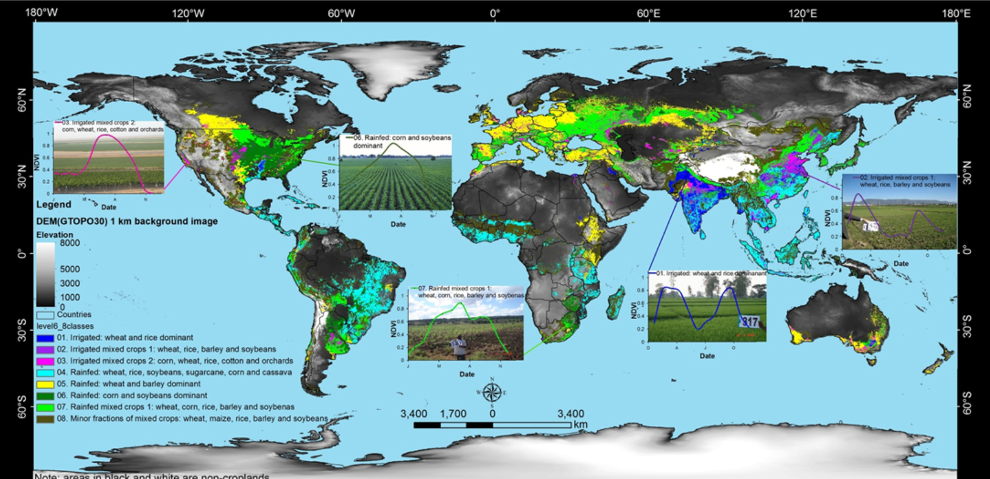

Slide 16
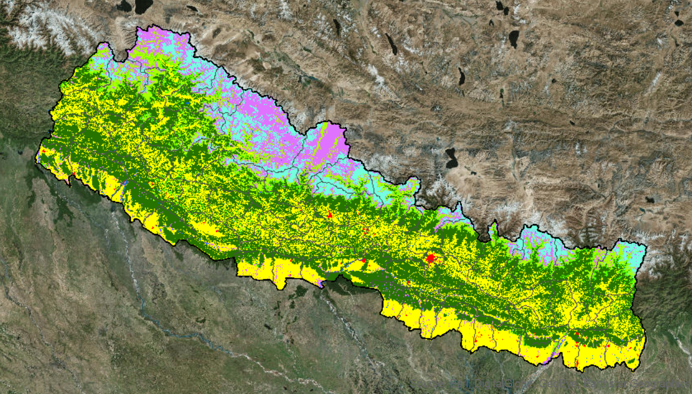
NASA funded project on Land cover monitoring of Nepal (1985-Present)

Slide 17
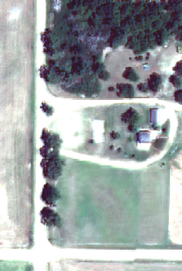
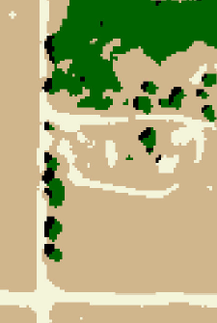
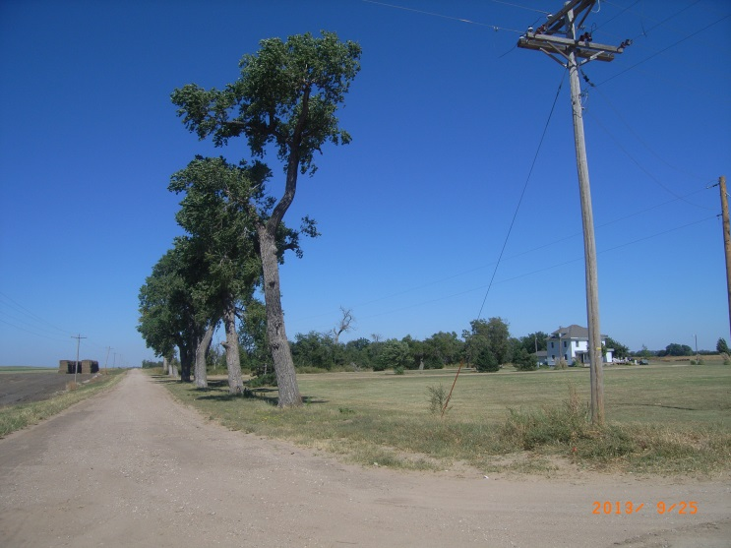
Field Verification
WorldView-2 image
Classification
Verified in the Field
Photo View
Photo View

Slide 18
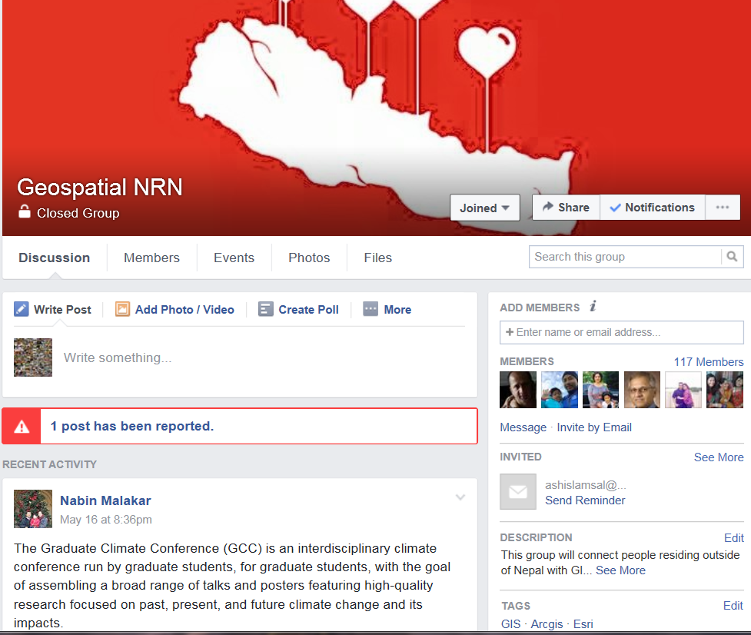

Slide 19
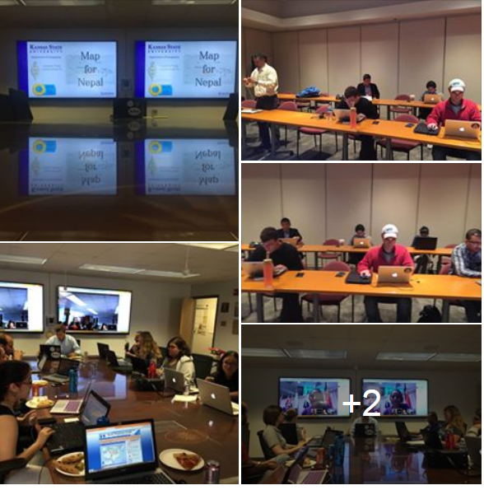
100+ volunteers from USA, Canada, Australia, Europe, Africa & South America

Slide 20
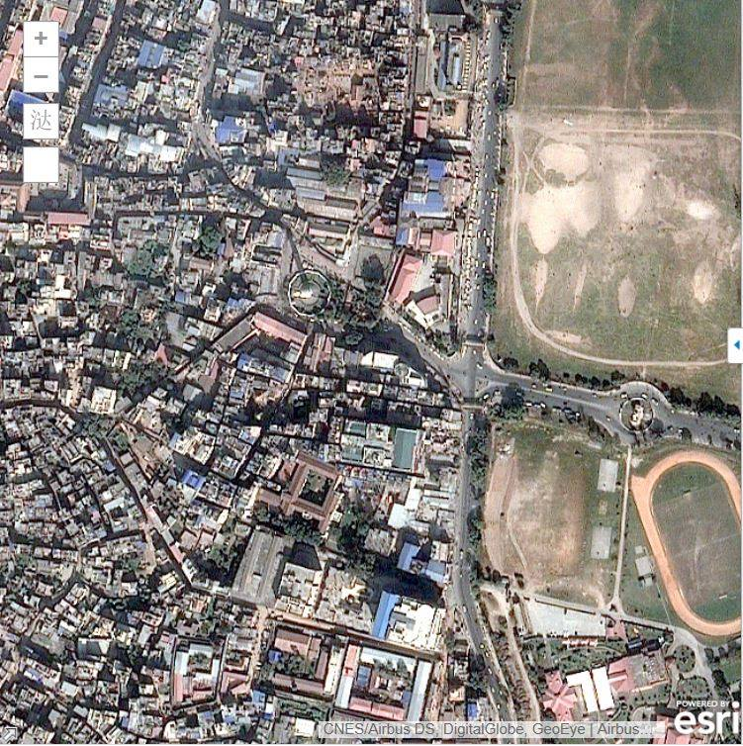
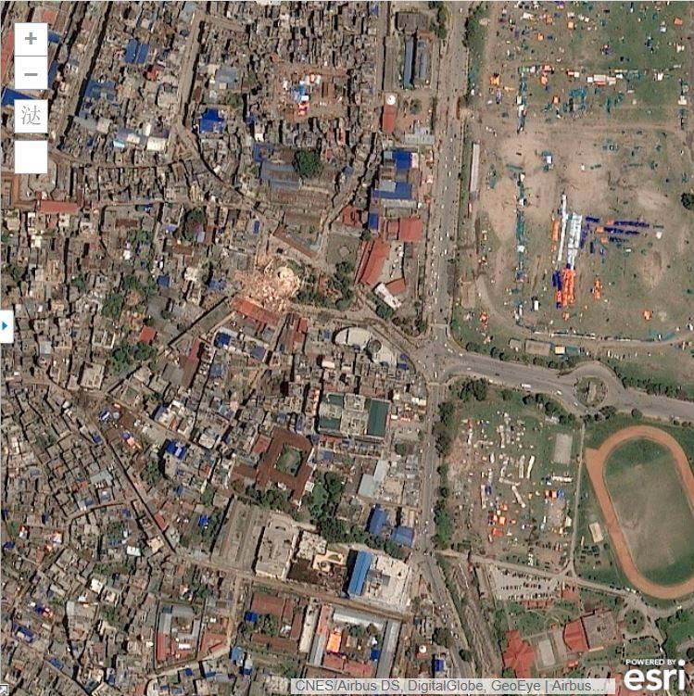
Dharhara, Kathmandu

Slide 21
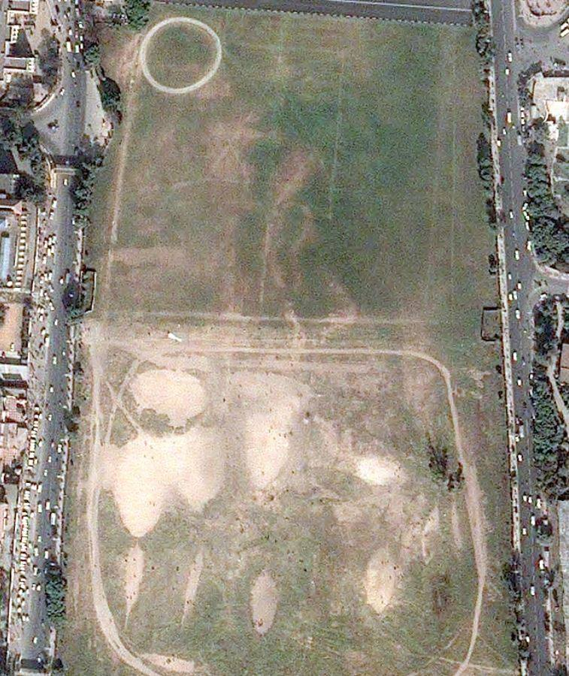
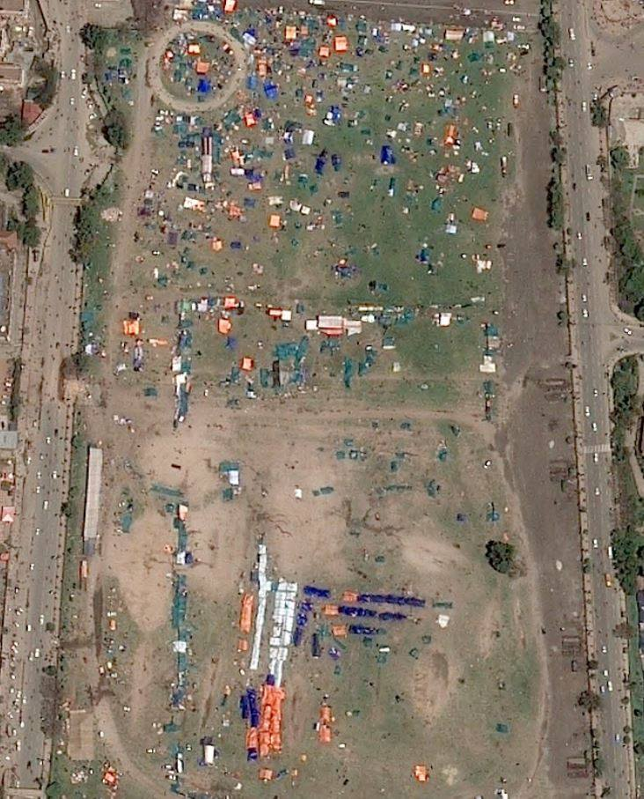
Tudikhel, Kathmandu

Slide 22
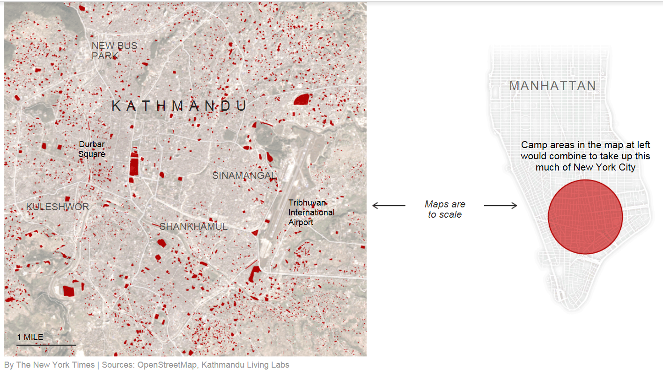

Slide 23
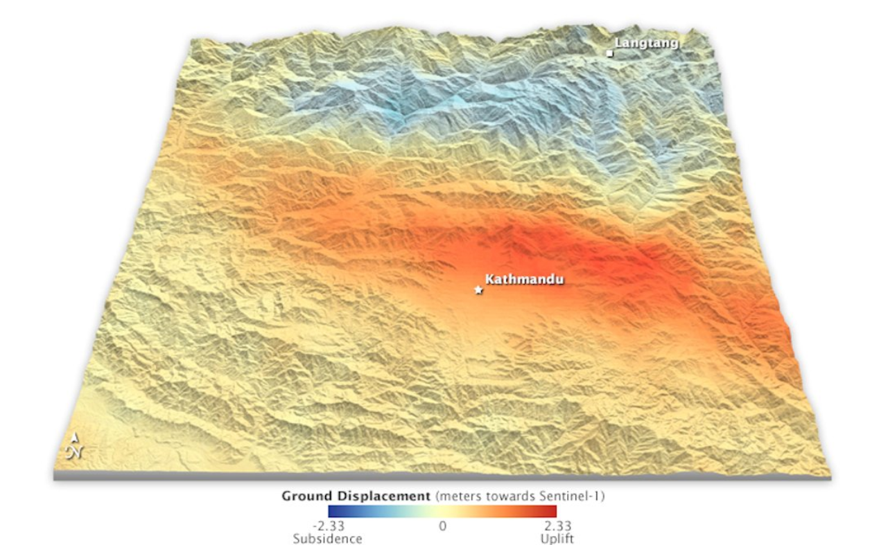

Slide 24
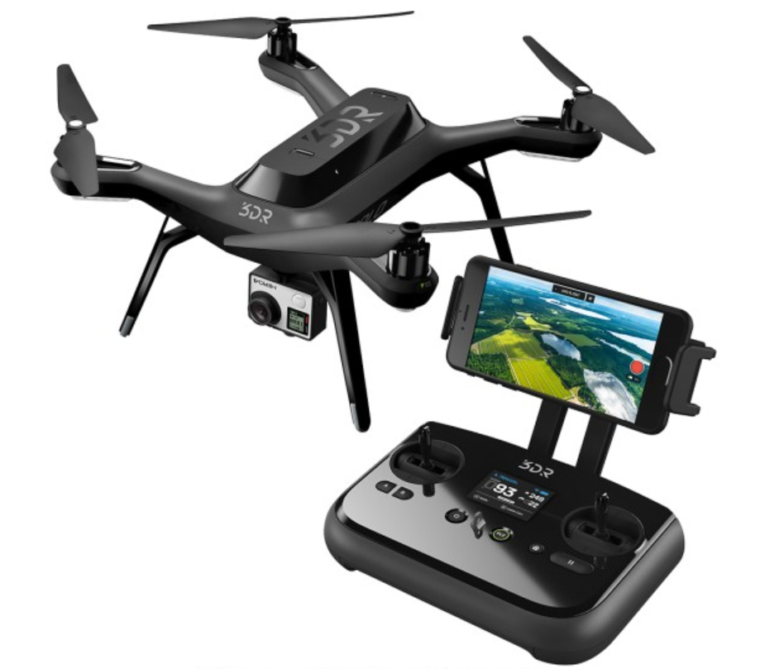
Future…
Drones
Global Internet
Broader User Base
(e.g. GPS)
Information Need
Planet Lab
Google SkyBox

